Slide 1
Ngrx/store
Core concepts

Slide 2
Major parts
Dispatcher
Stores
Views

Slide 3
Dispatcher
It’s a central hub that manages all data flow in a Flux application. It is essentially a registry of callbacks into the stores and has no real intelligence of its own — it is a simple mechanism for distributing the actions to the stores.

Slide 4
Dispatcher
Each store registers itself and provides a callback. When an action creator provides the dispatcher with a new action, all stores in the application receive the action via the callbacks in the registry.

Slide 5
Stores
Stores contain the application state and logic. Their role is somewhat similar to a model in a traditional MVC, but they manage the state of many objects — they do not represent a single record of data like ORM models do.
As mentioned above, a store registers itself with the dispatcher and provides it with a callback. This callback receives the action as a parameter.

Slide 6
Action Creators
It’s a semantic helper methods that sends the action to dispatcher.

Slide 7
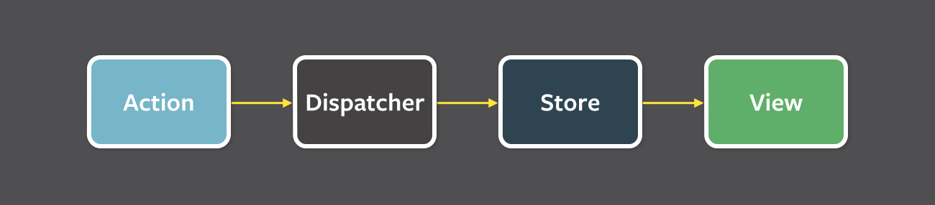
Data Flow
Data flows in a single direction
This is the primary mental model for the Flux programmer.

Slide 8
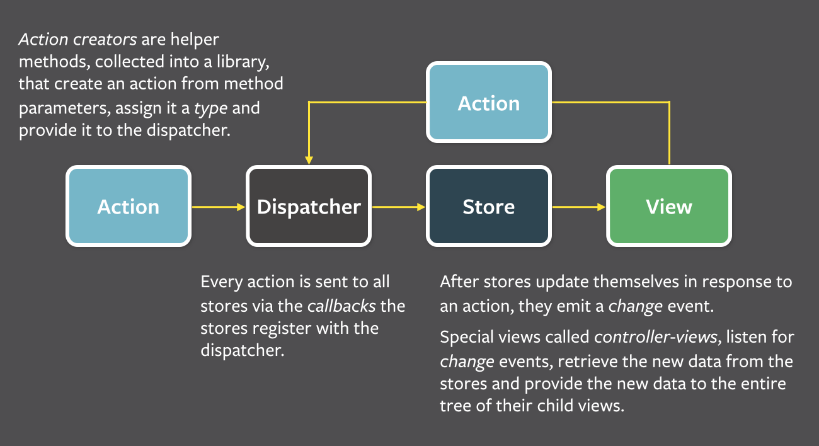
Structure

Slide 9
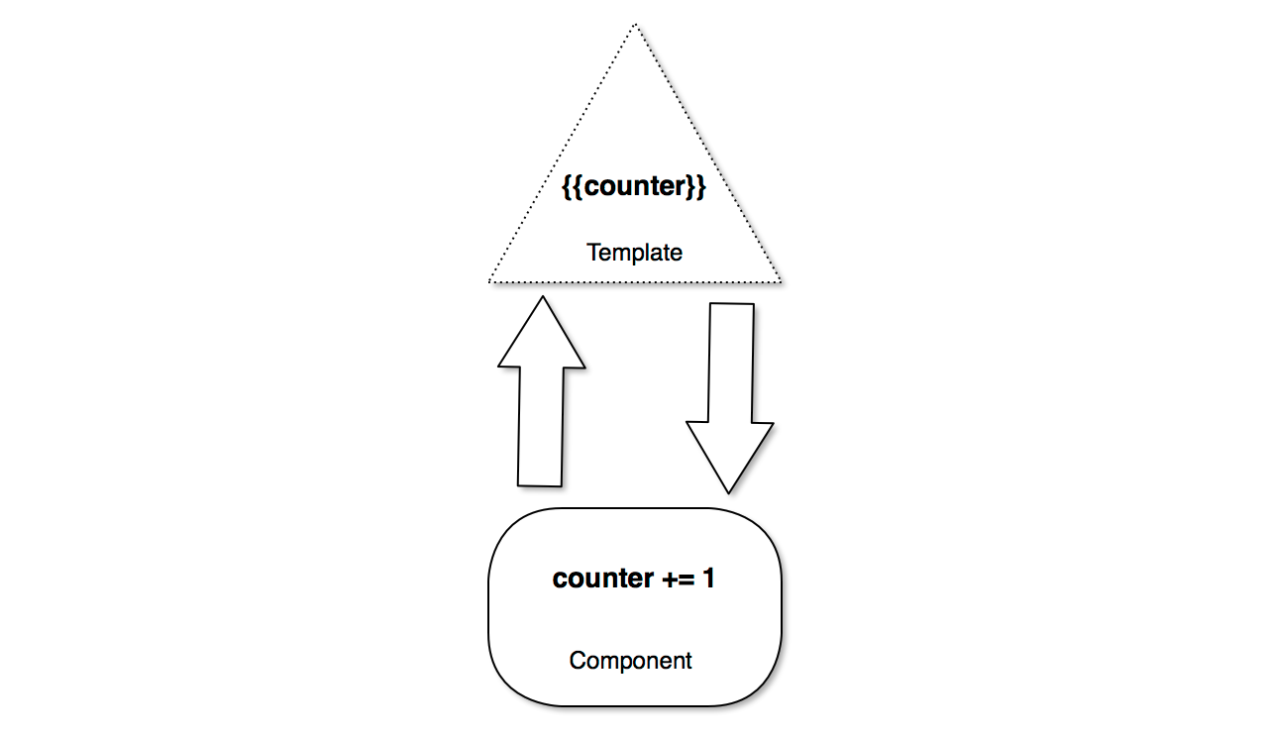
Two-way data binding

Slide 10
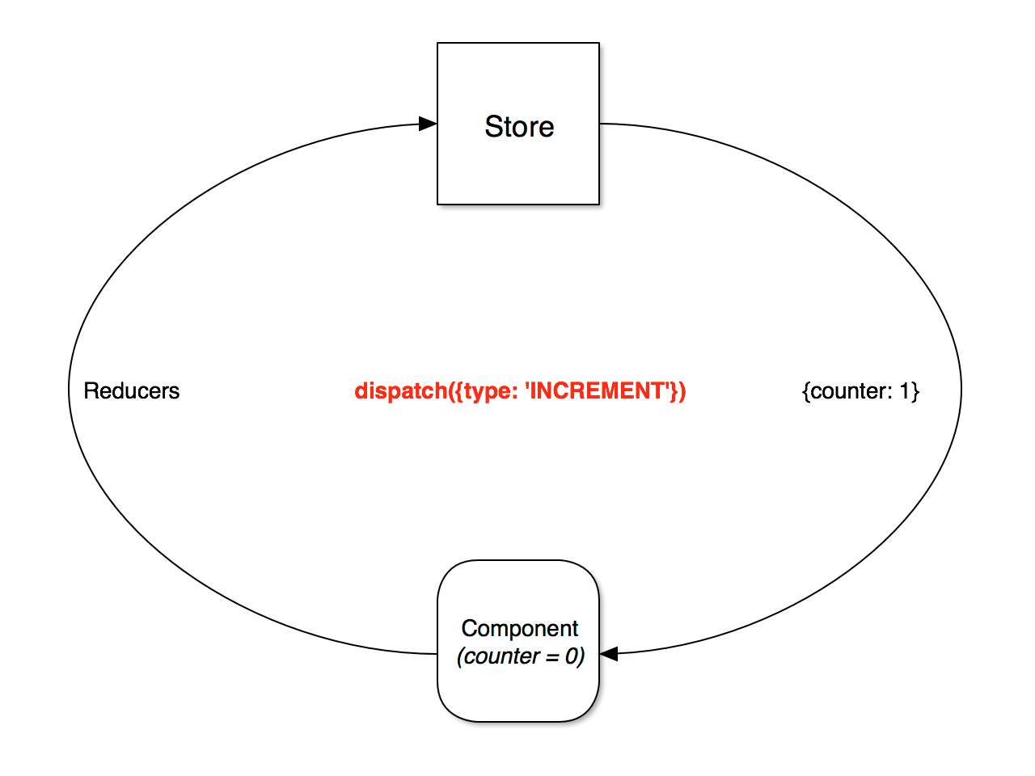
One-way data flow

Slide 11
Advantages of store
Centralized immutable state
Performance
Testability
Tooling and ecosystem*

Slide 12
Q&A

